Slide 1
National Conference of CIRC On Corporate laws- Ghaziabad, 20th & 21st Dec 2008 Cybercrimes and legal enforcement in India…
Karnika Seth
Cyber-lawyer & IP Expert
Partner,
SETH ASSOCIATES
ADVOCATES AND LEGAL CONSULTANTS © copyrighted Seth Associates Dec 2008

Slide 2
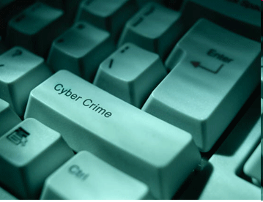
Introduction to Cyber Crime
Computer Crime, E-Crime, Hi-Tech Crime or Electronic Crime is where a computer is the target of a crime or is the means adopted to commit a crime.
Most of these crimes are not new. Criminals simply devise different ways to undertake standard criminal activities such as fraud, theft, blackmail, forgery, and embezzlement using the new medium, often involving the Internet

Slide 3
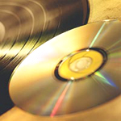
Computer vulnerability
Computers store huge amounts of data in small spaces
Ease of access
Complexity of technology
Human error
One of the key elements that keeps most members of any society honest is fear of being caught — the deterrence factor. Cyberspace changes two of those rules. First, it offers the criminal an opportunity of attacking his victims from the remoteness of a different continent and secondly, the results of the crime are not immediately apparent.
Need new laws and upgraded technology to combat cyber crimes

Slide 4
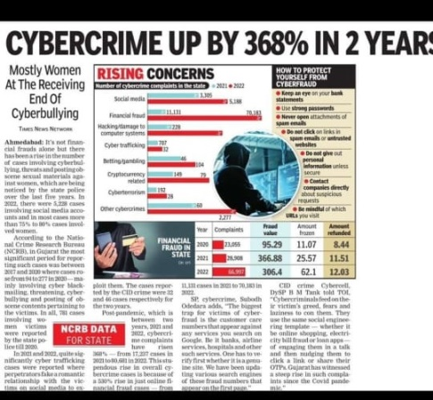

Slide 5
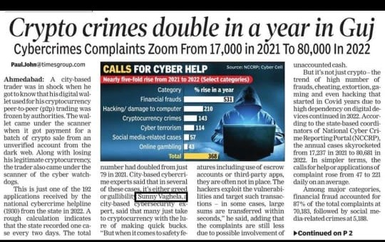

Slide 6
Different Types of Cybercrimes
Cyber crimes
Web jacking
Trojan
attacks
Hacking
Information
Theft
E-mail
bombing
Salami
attacks
Denial of
Service
attacks

Slide 7
Types of Cyber crimes
Credit card frauds
Cyber pornography
Sale of illegal articles-narcotics, weapons, wildlife
Online gambling
Intellectual Property crimes- software piracy, copyright infringement, trademarks violations, theft of computer source code
Email spoofing
Forgery
Defamation
Cyber stalking (section 509 IPC)
Phising
Cyber terrorism
Crime against Government
Crime against property
Crime against persons

Slide 8
TYPES OF CYBER CRIMES
E-Mail bombing: Email bombing refers to sending a large amount of e-mails to the victim resulting in interruption in the victims’ e-mail account or mail servers.
Data diddling: This kind of an attack involves altering the raw data just before it is processed by a computer and then changing it back after the processing is completed.
Salami attacks: These attacks are used for the commission of financial crimes. The key here is to make the alteration so insignificant that in a single case it would go completely unnoticed e.g. A bank employee inserts a program into bank’s servers, that deducts a small amount from the account of every customer
Denial of Service: This involves flooding computer resources with more requests than it can handle. This causes the resources to crash thereby denying authorized users the service offered by the resources.

Slide 9
Some common cybercrimes…
Phishing, the mass distribution of “spoofed” e-mail messages,
which appear to come from banks, insurance agencies, retailers or credit card companies and are designed to fool recipients into divulging personal data such as account names, passwords, or credit card numbers.
“Carding,” which entails using stolen credentials (and can include package reshipping, money moving, and identity theft schemes)
Compromised servers or “bots,” which may be launching cyber attacks or sending Spam

Slide 10
Cyber Crime Data In Regional Context
Carding:-
Carding is a serious threat to India, as it does not require a high degree of sophistication and is considered particularly pernicious by international financial institutions and e-commerce providers.
Bots:-
Bots, compromised servers that may be launching cyber attacks or sending Spam, were detected in the India IP space, including servers with the domain name.
Phishing:-
ISPs were able to point to a few examples of phishing capture sites being located on their servers, one targeting eBay (a frequent attack point for phishers).

Slide 11
Computer Viruses
Viruses
A computer virus is a computer program that can infect other computer programs by modifying them in such a way as to include a (possibly evolved) copy of it. Note that a program does not have to perform outright damage (such as deleting or corrupting files) in order to be called a "virus".
A computer virus is a program that can copy itself and infect a computer without permission or knowledge of the user.

Slide 12
Why Do people Create These Viruses?
To distribute political message.
To attack the products of specific companies.
Some consider their creations to be works of art, and see as a creative hobby.
Financial gain from identity theft

Slide 13
Types of Viruses
Types of viruses
Armored virus
Companion virus
Polymorphic virus
Macro virus
Boot sector virus
Stealth virus
Logic bomb
Sparse infector
Network viruses

Slide 14
Cyber Threats
Cyber Threats
Cyber threats to a control system refer to persons who attempt unauthorised access to a control system device and network using a data communications pathway.
Main threats to cyber crime is Hacking.
Hacking involves gaining unauthorised access to a computer and altering the system in such a way as to permit continued access, along with changing the configuration, purpose, or operation of the target machine, all without the knowledge or approval of the systems owners.

Slide 15
absents
84
88
127
208
vivek

Slide 16
New Internet Threats
All computers need internet security
Home users can lose valuable personal data with one click to the wrong website. Children trading games also exchange viruses unknowingly. You receive an email requesting an update to your payment details, and a hacker gains access to your bank account. A backdoor is installed on your machine, and your PC becomes a zombie, spewing out spam.
New technologies - new anti-malware solutions
As cyber threats have evolved, so has software to deflect such threats. Sophisticated antispyware and antivirus solutions capable of detecting the most complex new viruses are now available.

Slide 17
What Is Spam
Spam is the equivalent of physical junk mail and unsolicited telemarketing phone calls. It has become one of the largest nuisances to computer users for both home and business users.
There are two main types of spam, and they have different effects on Internet users.Cancellable Usenet spam is a single message sent to 20 or more Usenet newsgroups. (Through long experience, Usenet users have found that any message posted to so many newsgroups is often not relevant to most or all of them.) Usenet spam is aimed at "lurkers", people who read newsgroups but rarely or never post and give their address away. Usenet spam robs users of the utility of the newsgroups by overwhelming them with a barrage of advertising or other irrelevant posts. Furthermore, Usenet spam subverts the ability of system administrators and owners to manage the topics they accept on their systems.
Email spam targets individual users with direct mail messages. Email spam lists are often created by scanning Usenet postings, stealing Internet mailing lists, or searching the Web for addresses. Email spams typically cost users money out-of-pocket to receive. Many people - anyone with measured phone service - read or receive their mail while the meter is running, so to speak. Spam costs them additional money. On top of that, it costs money for ISPs and online services to transmit spam, and these costs are transmitted directly to subscribers.

Slide 18
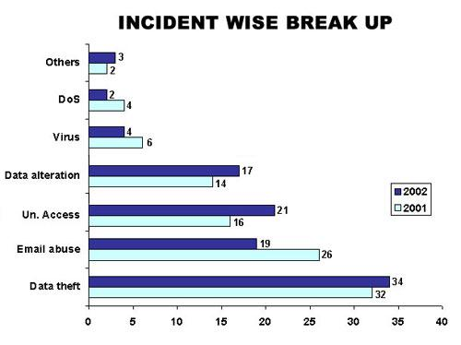
Frequency of incidents of Cyber crimes in India
Denial of Service:
Section 43
Virus: Section:
66, 43
Data Alteration:
Sec. 66
U/A Access
: Section 43
Email Abuse
: Sec. 67,
500, Other IPC Sections
Data Theft
: Sec 66, 65
Source: Survey conducted by ASCL

Slide 19
Frequency of reporting Cyber crimes in India
During the year 2005, 179 cases were registered under IT Act as compared to 68 cases during 2004 21.2% cases reported from Karnataka, followed by Maharashtra(26) , Tamil Nadu(22) and Chhattisgarh and Rajasthan (18 each) out of 179 cases, 50% were related to Section 67 IT Act.,125 persons were arrested. 74 cases of hacking were reported wherein 41 were arrested.

Slide 20
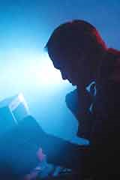
Combating cyber crimes
Technological measures- Public key cryptography, Digital signatures ,Firewalls, honey pots
Cyber investigation- Computer forensics is the process of identifying, preserving, analyzing and presenting digital evidence in a manner that is legally acceptable in courts of law.
These rules of evidence include admissibility (in courts), authenticity (relation to incident), completeness, reliability and believability.
Legal framework-laws & enforcement

Slide 21
Combating Cyber crime-Indian legal framework
Information Technology Act, 2000-came into force on 17 October 2000. Information technology Act 2000 consists of 94 sections segregated into 13 chapters. Four schedules form part of the Act.
Extends to whole of India and also applies to any offence or contravention there under committed outside India by any person {section 1 (2)} read with Section 75- Act applies to offence or contravention committed outside India by any person irrespective of his nationality, if such act involves a computer, computer system or network located in India
Section 2 (1) (a) –”Access” means gaining entry into ,instructing or communicating with the logical, arithmetic or memory function resources of a computer, computer resource or network
IT Act confers legal recognition to electronic records and digital signatures (section 4,5 of the IT Act,2000)

Slide 22
Civil Wrongs under IT Act
Chapter IX of IT Act, Section 43
Whoever without permission of owner of the computer
Secures access (mere U/A access)
Not necessarily through a network
Downloads, copies, extracts any data
Introduces or causes to be introduced any viruses or contaminant
Damages or causes to be damaged any computer resource
Destroy, alter, delete, add, modify or rearrange
Change the format of a file
Disrupts or causes disruption of any computer resource
Preventing normal continuance of computer

Slide 23
Civil Wrongs under IT Act (Contd.)
Denies or causes denial of access by any means
Denial of service attacks
Assists any person to do any thing above
Rogue Websites, Search Engines, Insiders providing vulnerabilities
Charges the services availed by a person to the account of another person by tampering or manipulating any computer resource
Credit card frauds, Internet time thefts
Liable to pay damages not exceeding Rs. One crore to the affected party
Investigation by
ADJUDICATING OFFICER
Powers of a civil court

Slide 24
Data diddling: changing data prior or during input into a computer
Section 66 and 43(d) of the I.T. Act covers the offence of data diddling
Penalty: Not exceeding Rs. 1 crore
Case in point :
NDMC Electricity Billing Fraud Case: A private contractor who was to deal with receipt and accounting of electricity bills by the NDMC, Delhi. Collection of money, computerized accounting, record maintenance and remittance in his bank who misappropriated huge amount of funds by manipulating data files to show less receipt and bank remittance.

Slide 25
Section 46 IT Act
Section 46 of the IT Act states that an adjudicating officer shall be adjudging whether a person has committed a contravention of any of the provisions of the said Act, by holding an inquiry. Principles of Audi alterum partum and natural justice are enshrined in the said section which stipulates that a reasonable opportunity of making a representation shall be granted to the concerned person who is alleged to have violated the provisions of the IT Act. The said Act stipulates that the inquiry will be carried out in the manner as prescribed by the Central Government
All proceedings before him are deemed to be judicial proceedings, every Adjudicating Officer has all powers conferred on civil courts
Appeal to cyber Appellate Tribunal- from decision of Controller, Adjudicating Officer {section 57 IT act}

Slide 26
Section 47, IT Act
Section 47 of the Act lays down that while adjudging the quantum of compensation under this Act, the adjudicating officer shall have due regard to the following factors, namely-
(a) the amount of gain of unfair advantage, wherever quantifiable, made as a result of the default;
(b) the amount of loss caused to any person as a result of the default;
(c) the repetitive nature of the default

Slide 27
Cybercrime provisions under IT Act,2000
Offence Relevant Section
under IT Act
Tampering with Computer source documents Sec.65
Hacking with Computer systems, Data alteration Sec.66
Publishing obscene information Sec.67
Un-authorized access to protected system Sec.70
Breach of Confidentiality and Privacy Sec.72
Publishing false digital signature certificates Sec.73

Slide 28
Section 65: Source Code
Most important asset of software companies
“Computer Source Code" means the listing of programmes, computer commands, design and layout
Ingredients
Knowledge or intention
Concealment, destruction, alteration
computer source code required to be kept or maintained by law
Punishment
imprisonment up to three years and / or
fine up to Rs. 2 lakh

Slide 29
Section 66: Hacking
•
Ingredients
–
Intention or Knowledge to cause wrongful loss
or damage to the public or any person
–
Destruction, deletion, alteration, diminishing
value or utility or injuriously affecting
information residing in a computer resource
•
Punishment
–
imprisonment up to three years, and / or
–
fine up to Rs. 2 lakh
•
Cognizable, Non Bailable,
Section 66 covers data theft aswell as data alteration

Slide 30
Sec. 67. Pornography
Ingredients
Publishing or transmitting or causing to be published
in the electronic form,
Obscene material
Punishment
On first conviction
imprisonment of either description up to five years and
fine up to Rs. 10 lakh
On subsequent conviction
imprisonment of either description up to seven years and
fine up to Rs. 10 lakh
Section covers
Internet Service Providers,
Search engines,
Pornographic websites
Cognizable, Non-Bailable, JMIC/ Court of Sessions

Slide 31
Computer Related Crimes under IPC and Special Laws
Sending threatening messages by email | Sec 503 IPC
Sending defamatory messages by email | Sec 499, 500 IPC
Forgery of electronic records | Sec 463, 470, 471 IPC
Bogus websites, cyber frauds | Sec 420 IPC
Email spoofing | Sec 416, 417, 463 IPC
Online sale of Drugs | NDPS Act
Web - Jacking | Sec. 383 IPC
Online sale of Arms | Arms Act

Slide 32
Some more offences dealt with under IPC…
Criminal breach of trust/Fraud- Sec. 405,406,408,409 IPC
Destruction of electronic evidence-Sec.204,477 IPC
False electronic evidence-Sec.193 IPC
Offences by or against public servant-Sec.167,172,173,175 IPC

Slide 33
Email spoofing:
Pranab Mitra , former executive of Gujarat Ambuja Cement posed as a woman, Rita Basu, and created a fake e-mail ID through which he contacted one V.R. Ninawe an Abu Dhabi businessmen . After long cyber relationship and emotional massages Mitra sent an e-mail that ‘‘she would commit suicide’’ if Ninawe ended the relationship. He also gave him ‘‘another friend Ruchira Sengupta’s’’ e-mail ID which was in fact his second bogus address. When Ninawe mailed at the other ID he was shocked to learn that Mitra had died and police is searching Ninawe. Mitra extorted few lacs Rupees as advocate fees etc. Mitra even sent e-mails as high court and police officials to extort more money. Ninawe finally came down to Mumbai to lodge a police case.

Slide 34
Legal provisions to counter identity theft
The IT Act 2000 in its present form does not have any specific provision to deal with identity theft. However, the Expert Committee on Amendments to the IT Act 2000 (whose report is presently under consideration by the government for adoption) has recommended amending the Indian Penal Code (IPC) by inserting in it two new sections:
section 417A which prescribes punishment of up to 3 years imprisonment and fine for 'cheating by using any unique identification feature of any other person'; and
section 419A that prescribes punishment of up to 5 years imprisonment and fine for 'cheating by impersonation' using a network or computer resource.

Slide 35
Forgery
Andhra Pradesh Tax Case
In the explanation of the Rs. 22 Crore which was recovered from the house of the owner of a plastic firm by the sleuths of vigilance department, the accused person submitted 6000 vouchers to legitimize the amount recovered, but after careful scrutiny of vouchers and contents of his computers it revealed that all of them were made after the raids were conducted . All vouchers were fake computerized vouchers.

Slide 36
Cyber stalking
Ritu Kohli (first lady to register the cyber stalking case) is a victim of cyber-stalking. A friend of her husband gave her phone number and name on a chat site for immoral purposes. A computer expert, Kohli was able to trace the culprit. Now, the latter is being tried for "outraging the modesty of a woman", under Section 509 of IPC.

Slide 37
Cyber defamation
SMC Pneumatics (India) Pvt. Ltd. v. Jogesh Kwatra: India’s first case of cyber defamation was reported when a company’s employee (defendant) started sending derogatory, defamatory and obscene e-mails about its Managing Director. The e-mails were anonymous and frequent, and were sent to many of their business associates to tarnish the image and goodwill of the plaintiff company.
The plaintiff was able to identify the defendant with the help of a private computer expert and moved the Delhi High Court. The court granted an ad-interim injunction and restrained the employee from sending, publishing and transmitting e-mails, which are defamatory or derogatory to the plaintiffs.

Slide 38
Online gambling: virtual casinos, Cases of money laundering
Cyber lotto case: In Andhra Pradesh one Kola Mohan created a website and an email address on the Internet with the address 'eurolottery@usa.net.' which shows his own name as beneficiary of 12.5 million pound in Euro lottery. After getting confirmation with the email address a telgu newspaper published this as news.
He gathered huge sums from the public as well as from some banks. The fraud came to light only when a cheque amounting Rs 1.73 million discounted by him with Andhra bank got dishonored.

Slide 39
FIR NO 76/02 PS PARLIAMENT STREET
Mrs. SONIA GANDHI RECEIVED THREATING E-MAILS
E- MAIL FROM
missonrevenge84@khalsa.com
missionrevenge84@hotmail.com
THE CASE WAS REFERRED
ACCUSED PERSON LOST HIS PARENTS DURING 1984 RIOTS

Slide 40
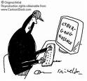
Cyber Crime Online Challenges
Brand exploitation
Unauthorized use of trademarks
Increased difficulty in managing online distribution channel
Sale of counterfeit goods

Slide 41
Current online Environment
Easy to “hide in plain sight”
Easy to confuse customers due to the high quality of digital copies
Difficult to track infringements
Easy to establish a professional-looking website

Slide 42
Common Forms of Online Threats
Trademark and Brand Infringement
Domain Name
Commercial sites (e.g., offensive content or competing companies)
Domain name monetization (e.g., click-through advertising)
Unhappy consumer sites (e.g., xxx-sucks. COM) (generally, protected)
Sale of Counterfeit Goods in Auction Sites
Logo, Text, and Meta Tag Use in Commercial Sites
Stopping unauthorized parties from using your trademarks
Managing partners use of logos and trademarks
Protecting against “Google bombing”

Slide 43
Domain theft
Domain theft is an aggressive form of domain hijacking that usually involves an illegal act. In most cases, identity theft is used to trick the domain registrar into allowing the hijacker to change the registration information to steal control of a domain from the legitimate owner.
Some registrars are quick to set things right when these cases are discovered. However, it is well documented that some registrars will admit no fault in accepting the forged credentials and will refuse to correct the record until forced by legal action. In many of these cases, justice is not done and the hijacker retains control of the domain.

Slide 44
Challenges of Cyber Security
The Environment
Explosion of computer and broadband internet availability (over a billion internet users today).
Low priority of security for software developers.
Challenge of timely patching vulnerabilities on all systems.
Graphical user interface (GUI) based tools that exploit known software vulnerabilities.

Slide 45
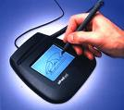
Electronic World
Electronic document produced by a computer. Stored in digital form, and cannot be perceived without using a computer
It can be deleted, modified and rewritten without leaving a mark
Integrity of an electronic document is “genetically” impossible to verify
A copy is indistinguishable from the original
It can’t be sealed in the traditional way, where the author affixes his signature
The functions of identification, declaration, proof of electronic documents carried out using a digital signature based on cryptography.

Slide 46
Electronic World
Digital signatures created and verified using cryptography
Public key System based on Asymmetric keys
An algorithm generates two different and related keys
Public key
Private Key
Private key used to digitally sign.
Public key used to verify.

Slide 47
Public Key Infrastructure
Allow parties to have free access to the signer’s public key
This assures that the public key corresponds to the signer’s private key
Trust between parties as if they know one another
Parties with no trading partner agreements, operating on open networks, need to have highest level of trust in one another

Slide 48
Role of the Government
Government has to provide the definition of
the structure of PKI
the number of levels of authority and their juridical form (public or private certification)
which authorities are allowed to issue key pairs
the extent to which the use of cryptography should be authorised for confidentiality purposes
whether the Central Authority should have access to the encrypted information; when and how
the key length, its security standard and its time validity

Slide 49
Section 3 Defines Digital Signatures
The authentication to be affected by use of asymmetric crypto system and hash function
The private key and the public key are unique to the subscriber and constitute functioning key pair
Verification of electronic record possible

Slide 50
Secure digital signature-S.15
If by application of a security procedure agreed to by the parties concerned, it can be verified that a digital signature, at the time it was affixed, was:
(a) unique to the subscriber affixing it;
(b) capable of identifying such subscriber;
(c) created in a manner or using a means under the exclusive control of the subscriber and is linked to the electronic record to which it relates in such a manner that if the electronic record was altered the digital signature would be invalidated,
then such digital signature shall be deemed to be a secure digital signature

Slide 51
IT Act –overview of other relevant provisions
Section 16- Central Government to prescribe security procedures
Sec 17 to 34- Appointment and Regulation of Controller and certifying authority
Sec 35 to 39- Obtaining DSC
Sec 40 to 42- Duties of Subscriber of DSC- exercise due care to retain the private key

Slide 52
Threats to cyber security- Methods Used To Penetrate Victim Machines
Trojan droppers and downloaders injected into pirate software which is distributed via file sharing p2p networks (kazaa, eDonkey etc.)
Exploiting vulnerabilities in MS Windows and popular applications such as IE & Outlook.
Email worms

Slide 53
Password Authentication protocol
Password authentication protocol, sometimes abbreviated PAP, is a simple authentication protocol used to a network access server used for example by internet service provider. PAP is used by point to point protocol. Authentication is a process of validating a user before allowing them access to server resources. Almost all network operating system remote servers support PAP.

Slide 54
10 Ways To Wireless Security
Use encryption - chances are bad guys won’t bother breaking it.
Use strong encryption - in case they are trying to break it, make it harder for them.
Change the default admin password - avoid using ‘password as the password.
Turn off SSID broadcasting - don’t ’shout’ to everybody in the neighborhood "come and try me."
Turn off WAP when not in use - do you leave your TV on running when you are not at home?

Slide 55
10 Ways To Wireless Security
Change your default SSID - yes, there are at least 50 other ‘linksys’ stations around, and they are easier to find.
Use MAC filtering - you give keys to your home only to trusted people - do the same with the wireless network.
Isolate the wireless LAN from the rest of the network - why did you think Titanic sank? Create levels of protection.
Control the wireless signal - unless you want to power the whole city, there is no need to use signal amplifiers.
Transmit on a different frequency - this is why we haven’t intercepted the aliens yet

Slide 56
Protection of Personal Information
Identifying Purposes:- The purposes for which personal information is collected shall be identified by the organization at or before the time the information is collected.
Accuracy:- Personal information shall be as accurate, complete, and up-to-date as is necessary for the purposes for which it is to be used.
Safeguards:- Personal information shall be protected by security safeguards appropriate to the sensitivity of the information.
Accountability:- An organization is responsible for personal information under its control and shall designate an individual or individuals who are accountable for the organization’s compliance with the following principles.
Openness:- An organization shall make readily available to individuals specific information about its policies and practices relating to the management of personal information.

Slide 57
Recommended cyber safety tips
Use antivirus softwares
change passwords frequently
insert firewalls
Adopt regular scanning against spyware
install software patches
uninstall unnecessary software
separate user accounts
maintain backup
check security settings
Perform IT audits

Slide 58
In case you have any queries …please feel free to write in at Karnika@sethassociates.com
SETH ASSOCIATES
ADVOCATES AND LEGAL CONSULTANTS
Corporate Law Office:
B-10, Sector 40, NOIDA-201301, N.C.R, India
Tel: +91 (120) 4352846, +91 9810155766
Fax: +91 (120) 4331304
E-mail: mail@sethassociates.com

